Slide 1

Paginated Reports
Using a published Power BI Dataset

Slide 2
Sue Bayes
https://www.linkedin.com/in/suebayes/
@sue_bayes
https://databayes.co.uk/

Slide 3
Session
Quick and easy reporting in Service
Using Report Builder to add parameters and filters to Paginated Report from Service
Subscription and email
Using Report Builder as a start
Building a Table
Adding a Graph
Considerations

Slide 4
Service
Why?
Printing more than one page
Legislative
Validation
Non-Power BI Users

Slide 5
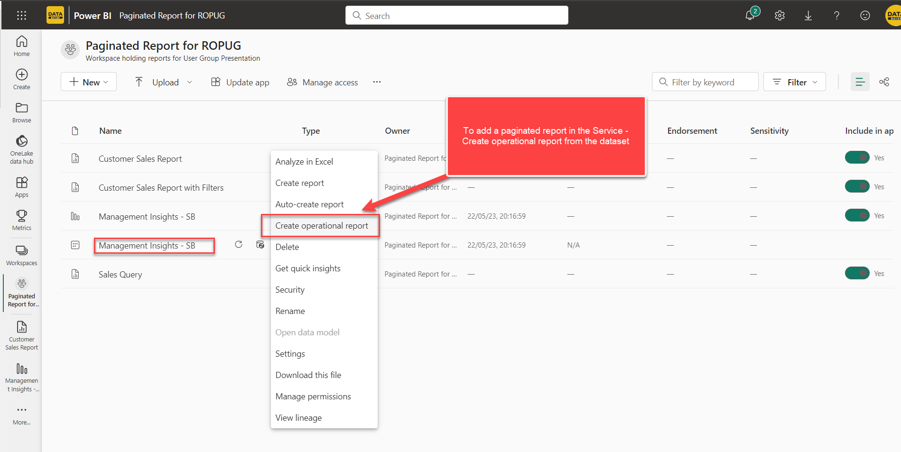
Report in Service
Notes:
Standard Power BI report visuals impose a 150,000 row limitation when using the Export data option. In contrast, with the paginated report visual, you can export up to 1,000,000 rows to Excel using the Export button in the toolbar, and retain all the formatting in the paginated report
Show options – format, build, print, export, save, filter – 10 mins
Limitations

Slide 6
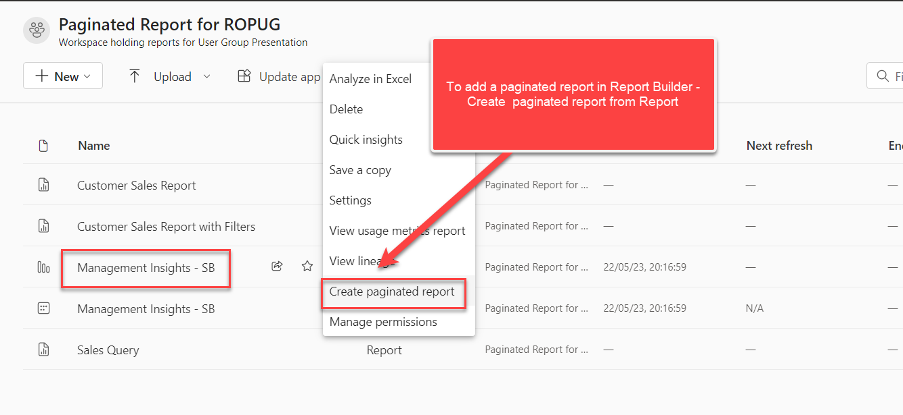
Report in Report Builder

Slide 7
Session
Quick and easy reporting in Service
Using Report Builder to add parameters and filters to Paginated Report from Service
Subscription and email
Using Report Builder as a start
Building a Table
Adding a Graph
Considerations

